Slide 1
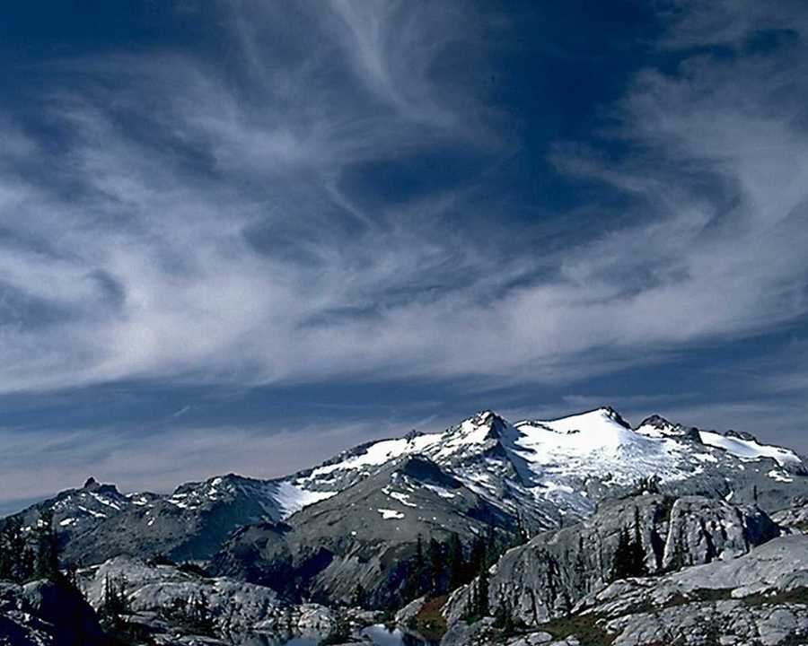
在祂没有难成的事
Nothing is impossible with Him

Slide 2
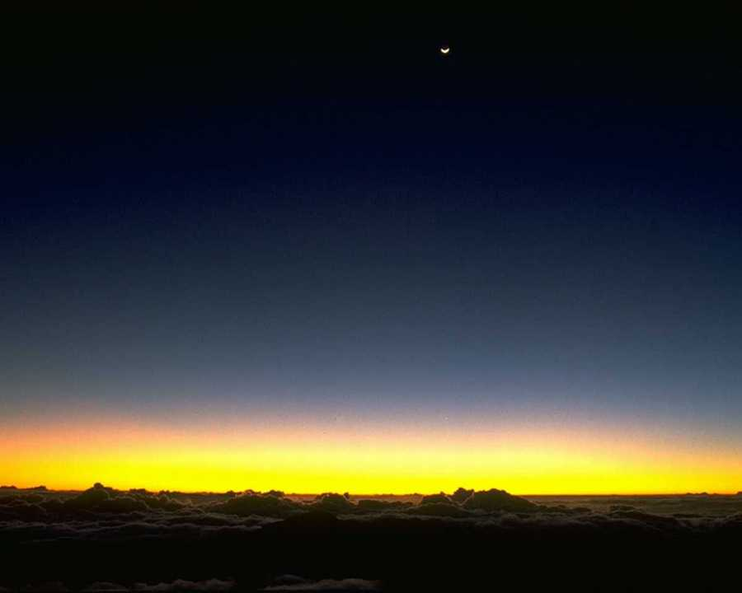
不论有多大有多难的事 ,
No matter how big how hard the problems
交托在全 能的上帝手里，
Cast them in the hands of the almighty God
不论有多大有多难的事 ,交托在上帝手里,
No matter how big how hard the problems
Cast them in the hands of God!

Slide 3
看！看耶和华成就大事，
Behold! Jehovah accomplished great things
祂说有就有，祂命立就立。
He speaks everything into being
看！看耶和华成就大事，
Behold! Jehovah accomplished great things
在祂没有难成的事！
Nothing is impossible with Him

Slide 4
不论有多大有多难的事 ,
No matter how big how hard the problems
交托在全 能的上帝手里，
Cast them in the hands of the almighty God
不论有多大有多难的事 ,交托在上帝手里,
No matter how big how hard the problems
Cast them in the hands of God!

Slide 5
看！看耶和华成就大事，
Behold! Jehovah accomplished great things
祂说有就有，祂命立就立。
He speaks everything into being
看！看耶和华成就大事，
Behold! Jehovah accomplished great things
在祂没有难成的事！
Nothing is impossible with Him

Slide 6
看！看耶和华成就大事，
Behold! Jehovah accomplished great things
祂说有就有，祂命立就立。
He speaks everything into being
看！看耶和华成就大事，
Behold! Jehovah accomplished great things
在祂没有难成的事！x2
Nothing is impossible with Him

Slide 7
哈~没有难成的事！
Ha, nothing is impossible.
全知全能神, 荣耀都归你！
All knowing, all powerful God,
All glory belong to you!
在你没有难成的事 X3
Nothing is impossible with Him.

Slide 8
没有难成的事。
Nothing is impossible
哈利路亚! x3
Hallelujah

